Slide 1

Music Recognition using Machine Learning
National Institute of Technology Calicut
Department of Computer Science and Engineering
Naredla Rohith Reddy | B200794CS
Kanchireddy Varshith Reddy | B220832CS
Vangur Ebenezer Rahul Deepak | B200818CS
Guide Name : Manjusha K

Slide 2
Problem Statement
Our project aims to develop a music recognition system capable of identifying songs even when they are played in the background, sung by ordinary individuals without using instruments, or hummed by someone.

Slide 3
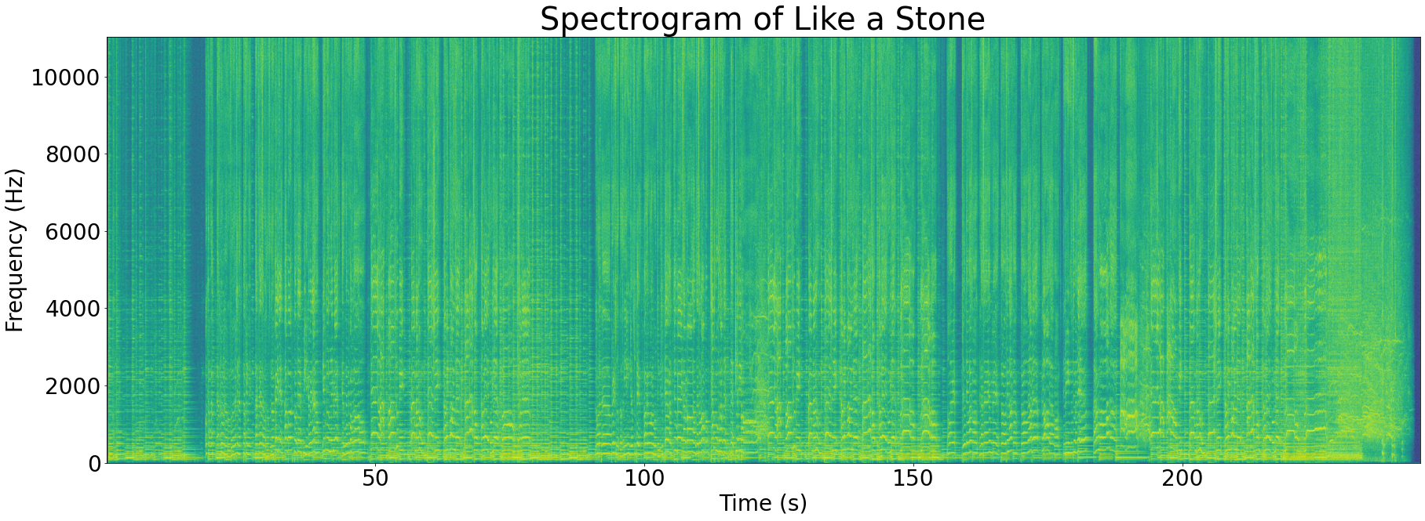
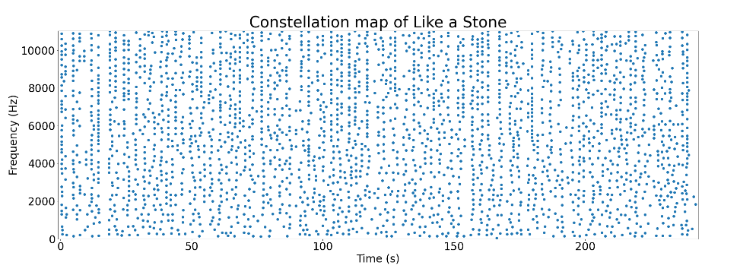
LITERATURE SURVEY
APPROACH 1
They first convert the audio to a spectrogram.
Then we identify peaks within the songs using a maximum filter.
To sparse the data they selected the top N peaks (N being proportional the length of the song).

Slide 4
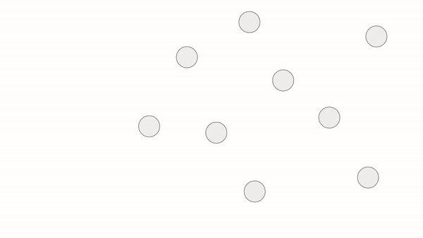
LITERATURE SURVEY
And then they form pairs of points and store each pair in the database i.e key being (f1, f2, time_diff).
This procedure relies on the fact that even in the presence of noise the peaks are preserved.
And also saving the pairs of frequencies along with the time difference between them instead of saving each point and their absolute time allows us to search the song efficiently and allows the query to be from any arbitrary section of the song.

Slide 5

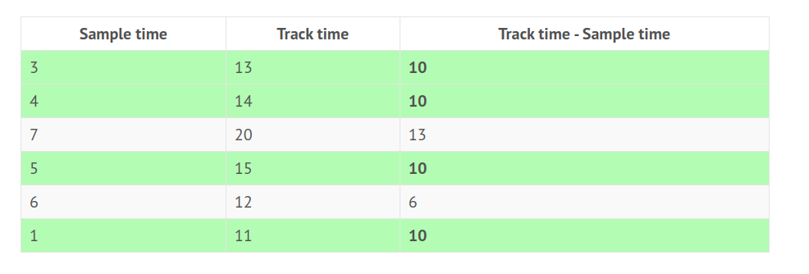
LITERATURE SURVEY
KEY
TIME DIFFERENCE PER SONG

Slide 6
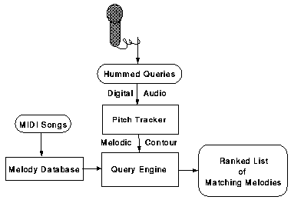
LITERATURE SURVEY
APPROACH 2:
They transform the audio into a sequence of pitch transitions i.e. S referring to the Same as the previous, D lower than the previous, and U higher than the previous so we transform our query to get a sequence of characters and hand it over to search.
The main components of this approach are the pitch tracker and Query Engine.
The pitch tracker here uses a technique called autocorrelation to generate the sequence.
Then they search the query using Fuzzy search

Slide 7
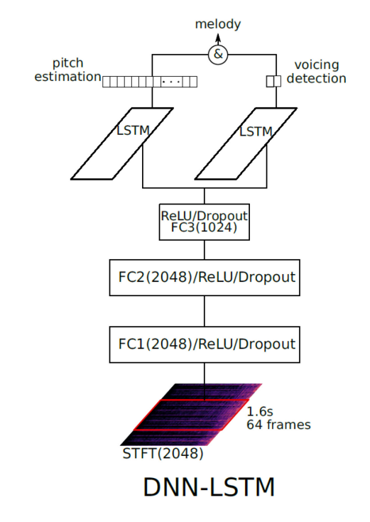
LITERATURE SURVEY
APPROACH 3
These papers use DNN-LSTM to generate a more complex descriptor of the music.
They have used a multitasking model that learns on two tasks: pitch estimation and voicing (i.e., presence of melody or not) detection.
thereby being able to work even on a polyphonic complex musical recording.
The pitch estimation part and the voicing detection part both are classification neural networks.

Slide 8
LITERATURE SURVEY
APPROACH 3
After the generation of the sequence, they convert the sequence into a sequence of relative differences in the original sequence and they employ a unified search that uses an n-gram inverted index to search in RP4G, RP3G, and RP2G.

Slide 9
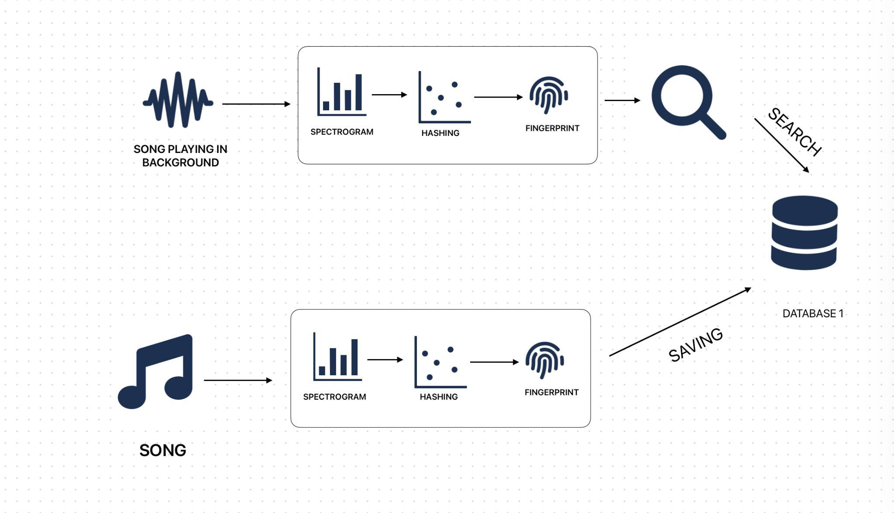
DESIGN
COMPONENT 1
Our design consists of two components
First component is meant to retrieve a
song when played in background using
the method described above.
Second component is meant to retrieve a
song when query is sung or hum by a per
Song or sung in background.

Slide 10
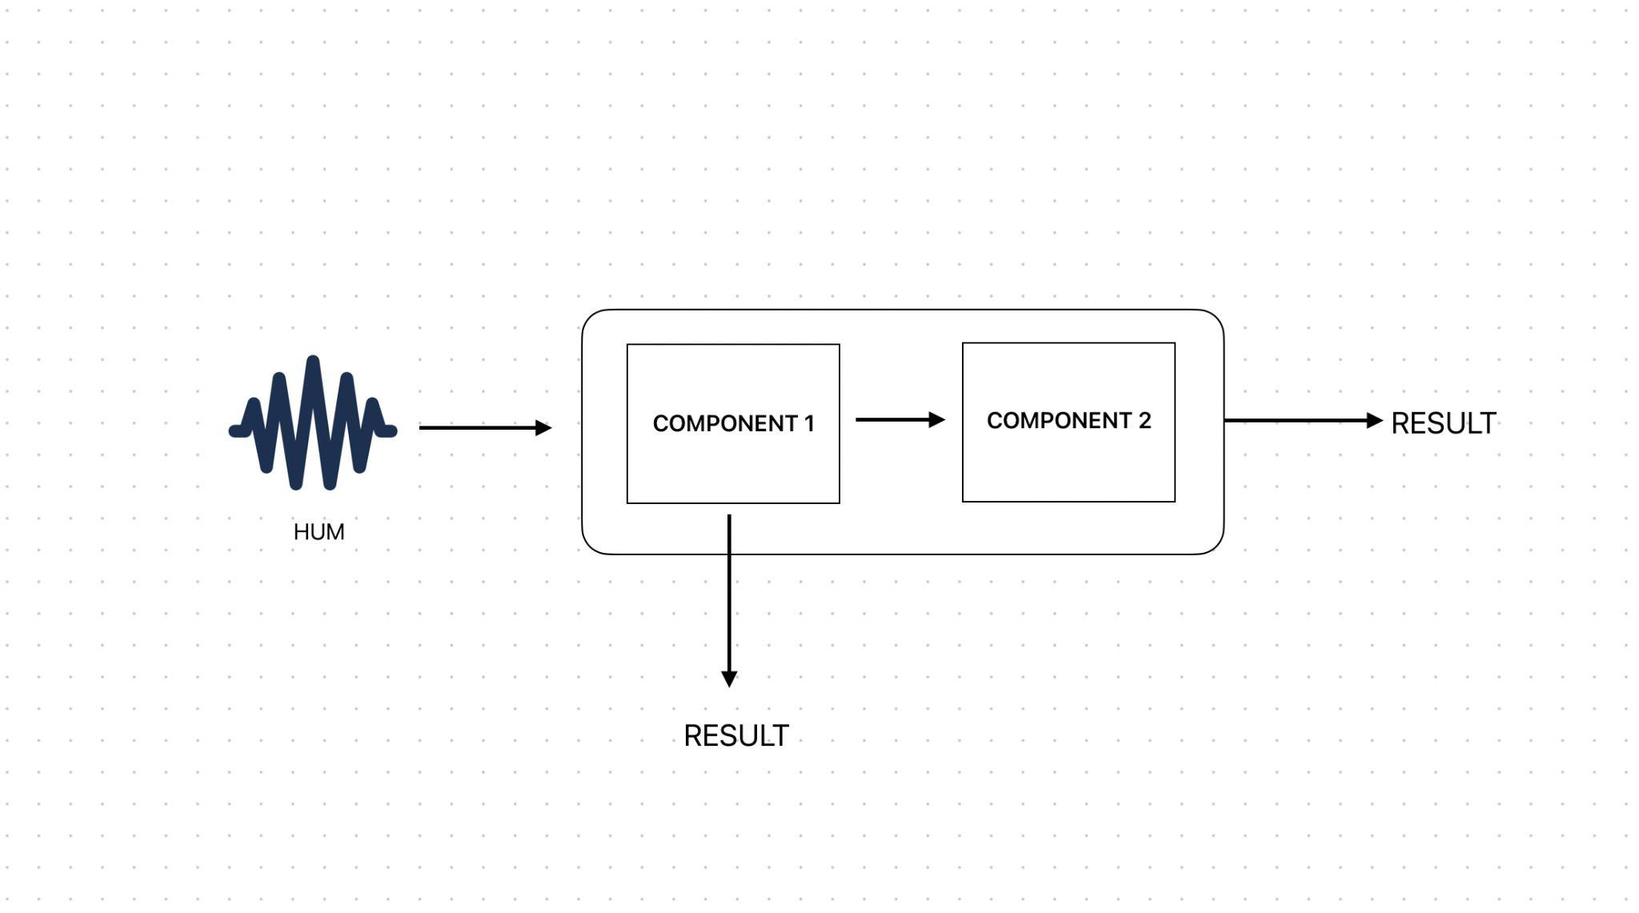
DESIGN
So whenever we have a query the query is fed to the first component then if it finds a match with a score greater than a threshold value we return the match i.e we output top
5 songs
In case it doesn't have enough score, we feed it into the second component then we return the match from here i.e we output the top 5 songs

Slide 11
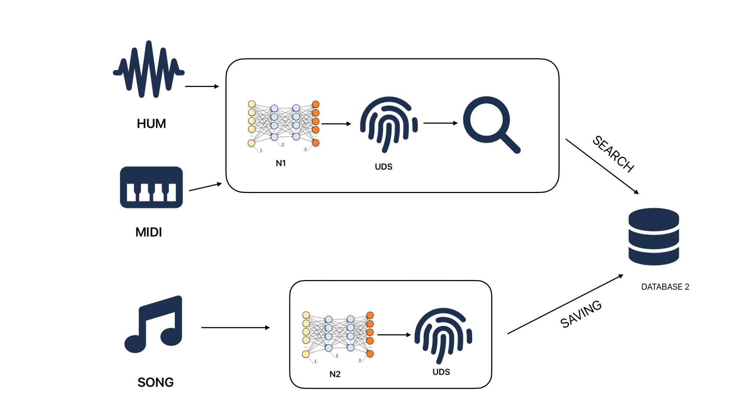
DESIGN
COMPONENT 2
This component involves two
neural networks.
They are
1. Hum/MIDI to UDS (N1)
2. Original Song to UDS (N2)
N1 takes input as two successive frames
of audio as input(i.e a small time sample of
audio) and generate an descriptor(UDS) for
that instance.we do this for entire song.

Slide 12
DESIGN
COMPONENT 2
N2 takes in the original song the input same as
N1, we split the song into small time frames
and generate a UDS annotation for entire song.
A single audio frame here is nothing but, say if the sample time for each frame is 5ms, we register all the frequencies within that 5ms and their corresponding amplitudes. And store it in array.

Slide 13
DESIGN
COMPONENT 2
To train this neural network we have taken the
MIDI version of the original song and it’s
a UDS annotation and used it as the
expected output of N2 for the song.

Slide 14
EXPERIMENTS
The design is subject to change with results from our experiments.
Experimenting with Higher Resolution Annotation Beyond 3 Descriptors
we will try to use more descriptors like S (same), h (up), H (very high), l (low), L(very low)
We would see if this can improve the matching rate
Experimenting with inputs of N1, N2. i.e as mentioned in the design we would take 2 frames (curr, prev). And also try and check whether increasing the number of previous frames would result in better accuracy.
We would like to experiment with size of time slice of a frame i.e sample time for frame.

Slide 15
EXPERIMENTS
As for Now Both N1 and N2 are feed forward classification networks with outputs as U, D, S
But we would like to see especially for N2 whether a DNN-LSTM can perform better

Slide 16
Search
Search in component 1
we use hash key (f1,f2, delta t).
Then we give result as described in approach 1 of Literature Survey.
Fuzzy search in component 2:
The degree of similarity between a UDS sequence of hum and any arbitrary sequence from a song is assessed by measuring the number of fundamental operations required to achieve an exact match.
Fundamental operations are:insertion,deletion,substitution.
We calculate similarity using the formula
Similarity = 1 - edit_distance / min(len(term), len(word))

Slide 17

EVALUATION METRICS
We are using mean reciprocal rank for measuring accuracy of the model.
The mean reciprocal rank is a statistic measure for evaluating any process that produces a list of possible responses to a sample of queries.
The mean reciprocal rank is the average of the reciprocal ranks of results
for a sample of queries Q where rank(i) refers to the rank position of the
first relevant document for the i-th query.

Slide 18
EVALUATION METRICS
1, 3, 5, 10 Hit Ratios
We would calculate how many time our original query is the top result, query is in top 3 results etc …
We would use these metrics to compare our models performance while experimenting. And also use this metrics to compare our results with the other approaches detailed in Literature Survey

Slide 19
THANK YOU

